Slide 1
Gen AI based Data Profiling Automating Compliance: Transforming Regulatory Reporting with AI Efficiency.
March 2025
To W.W.

Slide 2
Executive Overview
Problem Statement:
Regulatory reporting in banking requires compiling and profiling data to ensure compliance, which is often done manually by defining rules based on complex regulatory documents.
This process is time-consuming and error-prone, making it difficult to meet regulatory standards efficiently.
Solution:
The solution automates data profiling by parsing regulatory documents using an LLM to generate rules.
These rules are then applied to classify customer data into risk types, flagging risks, and suggesting remediation actions, improving compliance accuracy and efficiency.
Qualitative Business Value
Improved Accuracy in Compliance: False positives reduced from 42% to 9%.
Increased Employee Productivity: 50% reduction in compliance hours (9,660 hours saved/quarter).
Reduced Risk of Regulatory Penalties: Penalties reduced from $8.2M to $0.3M annually.
Quantitative Business Value
Labor Cost Savings: $4.3M saved annually; 68% of banks plan workforce restructuring.
Regulatory Penalty Reduction: $7.9M saved annually in penalties ($8.2M → $0.3M).
Cloud-Based Regulatory Tech Savings: 70% lower server costs, contributing to $12M annual savings.

Slide 3
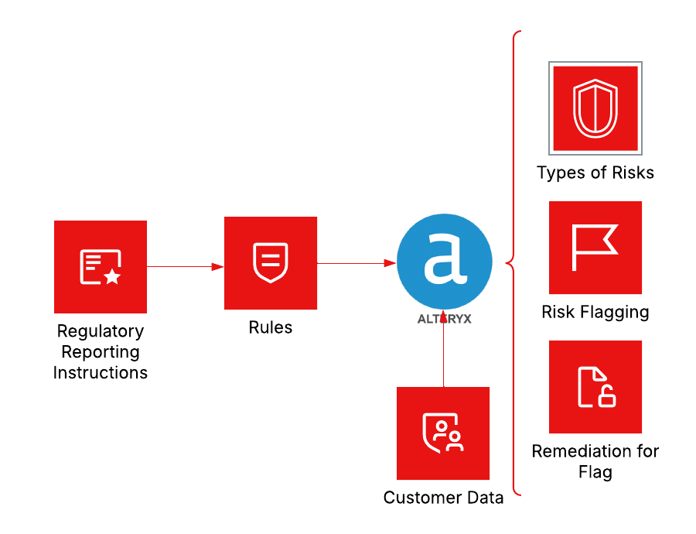
Current State – Existing Methodology
Manual Process
Automated Process

Slide 4
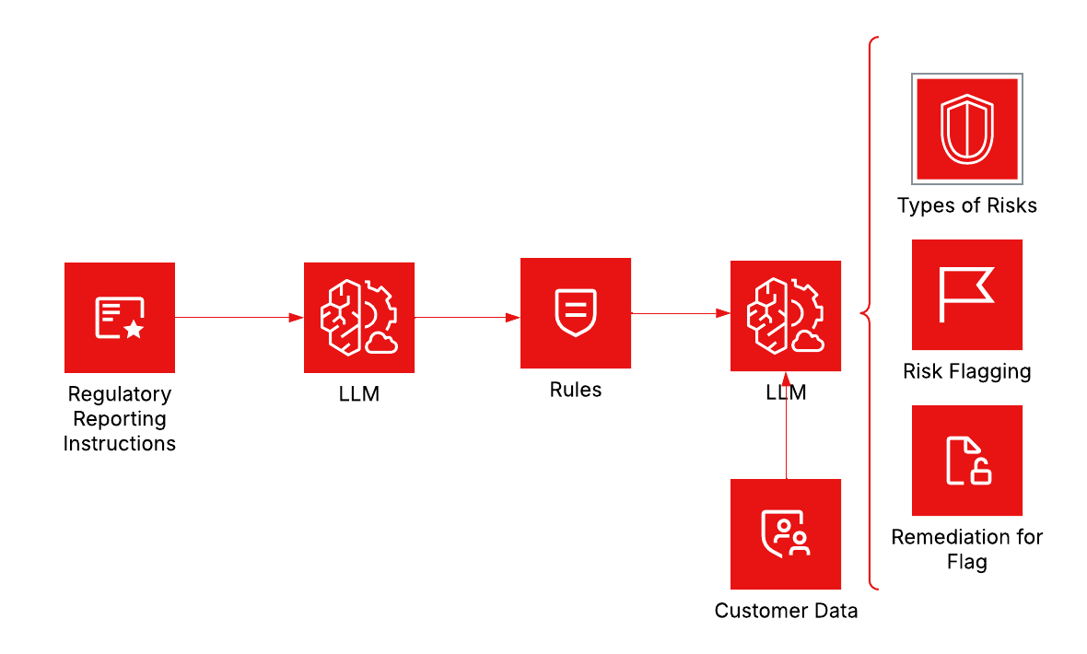
High Level Solution Overview
Intelligent Automation
The data profiling platform processes federal Regulatory Reporting Instructions using an LLM to convert them into rules.
These rules validate customer data, identifying risks.
A second LLM categorizes risks into types like Risk Flagging and Remediation for Flag, ensuring banks comply with regulations efficiently.

Slide 5
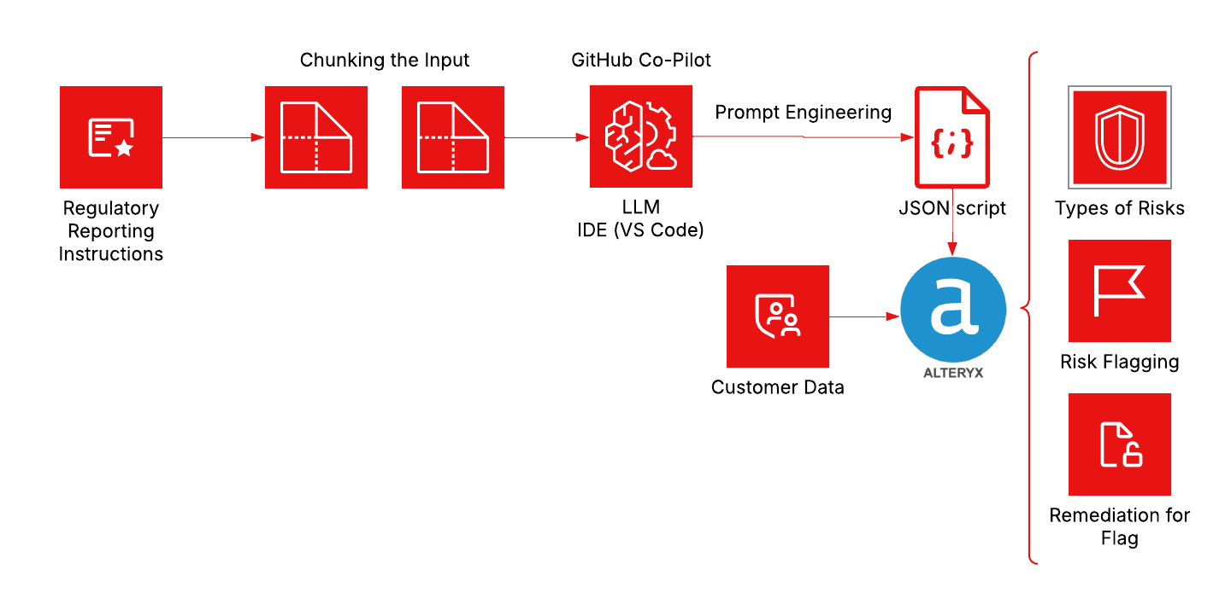
Proposed Methodology Implementable in Organization
Intelligent Automation
Existing Automated Process
The Alteryx platform ensures banks comply with federal Regulatory Reporting Instructions.
It converts these government documents into rules, which are then used to validate customer data.
The platform identifies risks, categorizing them into types such as Risk Flagging and Remediation for Flag, ensuring efficient regulatory compliance.

Slide 6
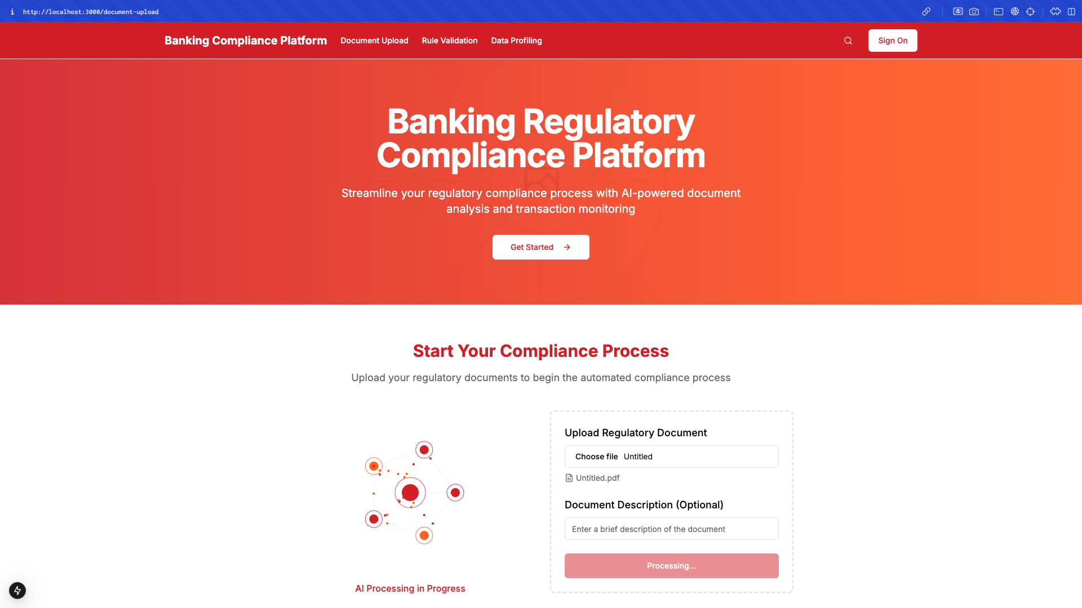
Regulatory Instruction to Rule Generation
Document Validation
AI Engines
Grok & OpenAI neural networks
Advanced computational intelligence
Synchronized regulatory processing
Intelligent Chunking
Granular instruction segmentation
Precise document fragmentation
Rule Extraction Mechanics
Semantic parsing algorithms
Probabilistic rule generation

Slide 7
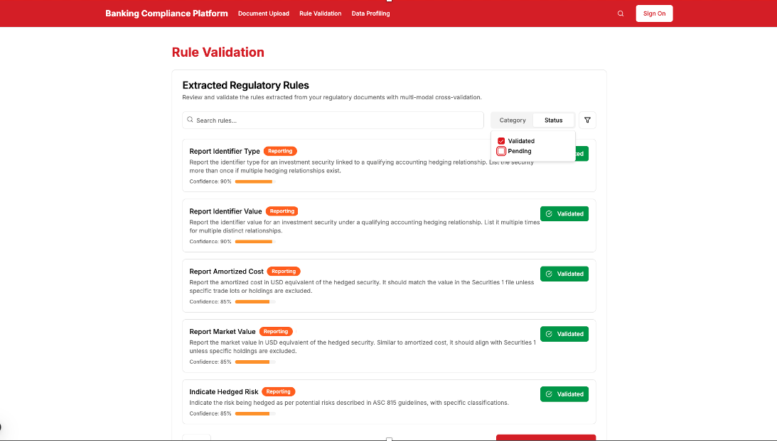
Precision Regulatory Rule Validation
Rule Validation
Cross-Model Validation Mechanism
Grok and OpenAI AI Engines
Simultaneous rule cross-referencing
Probabilistic compliance verification
Rule Optimization Strategies
Semantic divergence analysis
Compliance rule reconciliation
Computational rule refinement

Slide 8
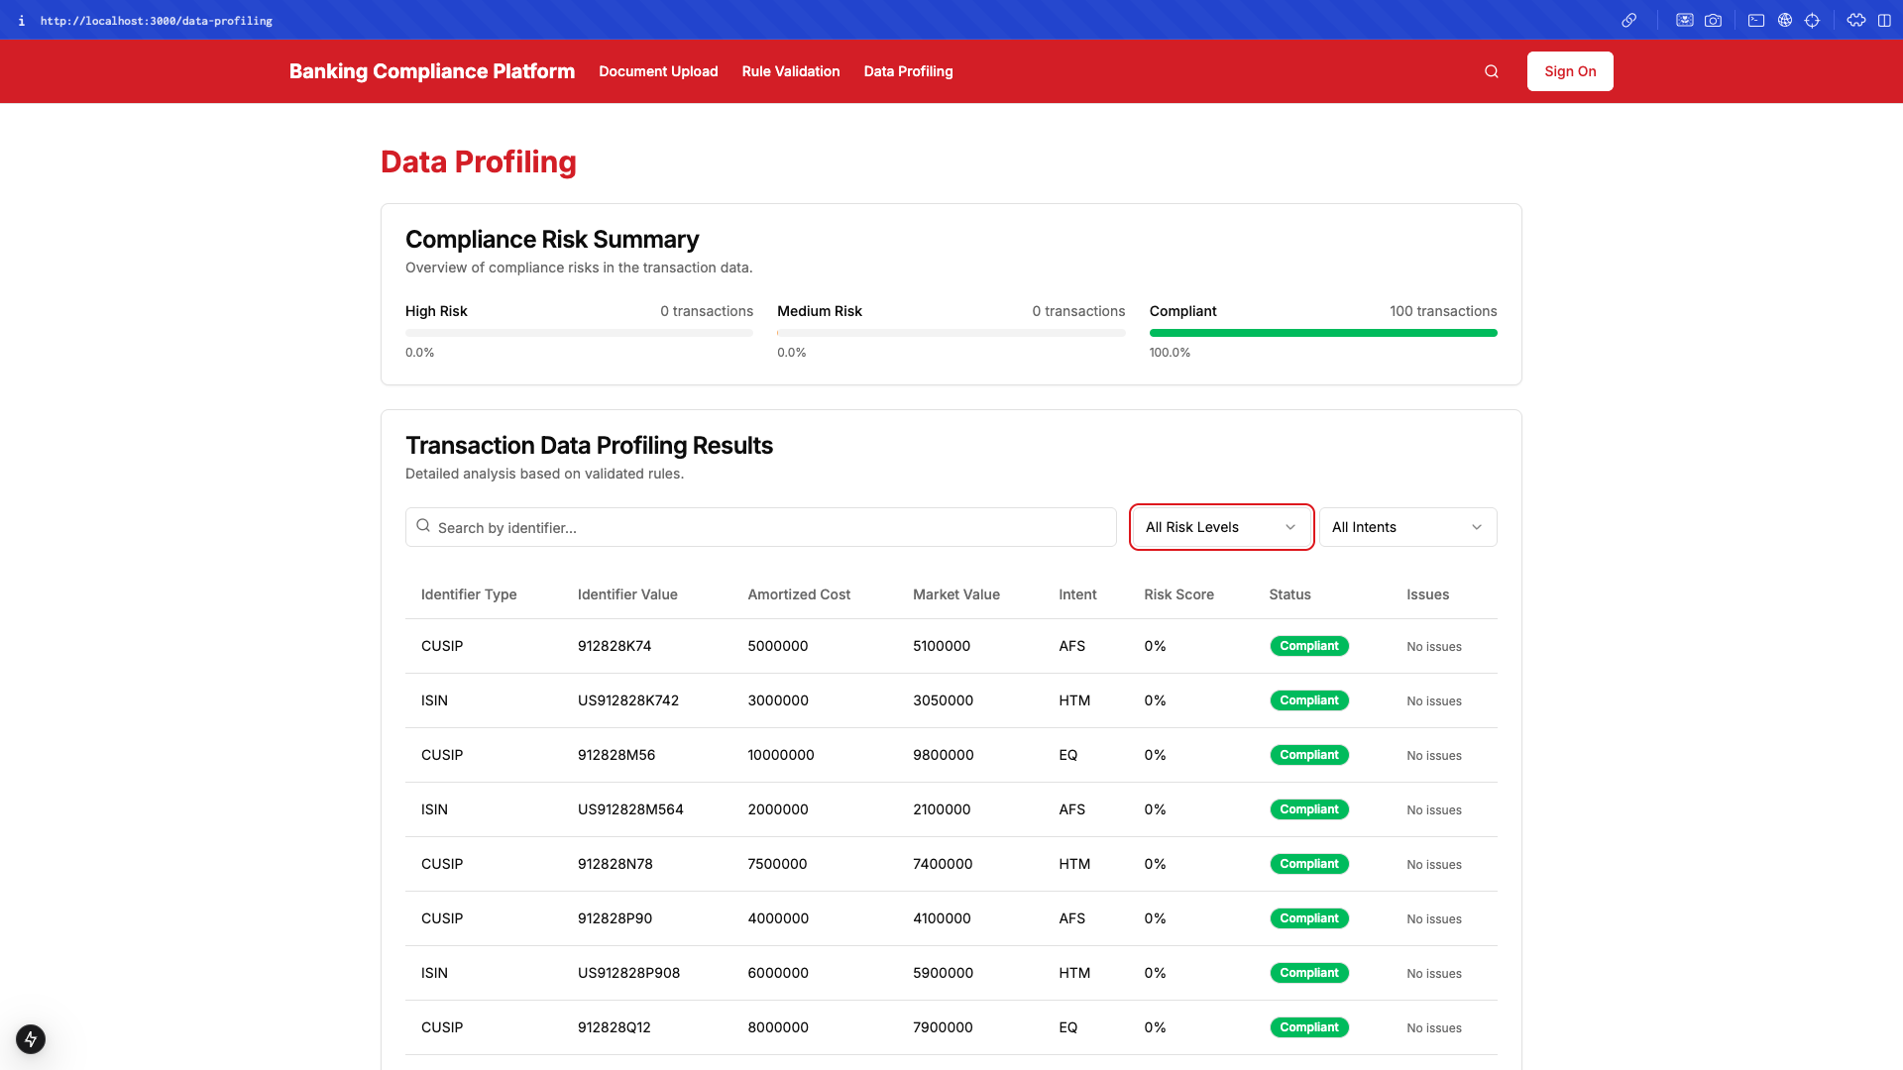
Data Profiling and Remediation Actions
Data Profiling
Data Profiling & Validation Mechanism
Grok AI Engines
Simultaneous rule cross-referencing
Probabilistic rule compliance verification

Slide 9

Demo
https://drive.google.com/file/d/1DO-Uj6YmKLjXbRI6ugxNdlBsdvWhHYEg/view?usp=sharing
https://drive.google.com/file/d/1uItA6BugbqC8IujQAPtql1u00jzumaOi/view?usp=sharing

